Slide 1
第14章 深度学习
（Part 2）
卿来云
lyqing@ucas.ac.cn

Slide 2
深度学习简介
神经元结构
全连接前馈神经网络
为什么要用深度模型
卷积神经网络
循环神经网络
自注意力
Transformer
Outline

Slide 3
复杂的输入
输入是一个向量
输入是一系列向量
模型
类别/标量
模型
类别/多个标量/多个向量
(长度可能变化)
Notes:
Attention is a concept that helped improve the performance of neural machine translation applications

Slide 4
例：一系列向量输入
this is a cat
One-hot Encoding
Word Embedding
apple = [ 1 0 0 0 0 …… ]
dog
bag = [ 0 1 0 0 0 …… ]
rabbit
run
cat = [ 0 0 1 0 0 …… ]
jump
cat
dog = [ 0 0 0 1 0 …… ]
tree
flower
elephant = [ 0 0 0 0 1 …… ]

Slide 5
上下文建模
CNN：局部上下文
RNN能保存全部历史信息，但一个隐含状态表达的信息有限，且不能并行
FC
FC
FC
FC
窗口
I
saw
a
saw
Notes:
Attention is a concept that helped improve the performance of neural machine translation applications

Slide 6

自注意力（Self-attention）
FC
FC
FC
FC
上下文
Self-attention
Notes:
https://arxiv.org/abs/1706.03762
天涯若比邻

Slide 7

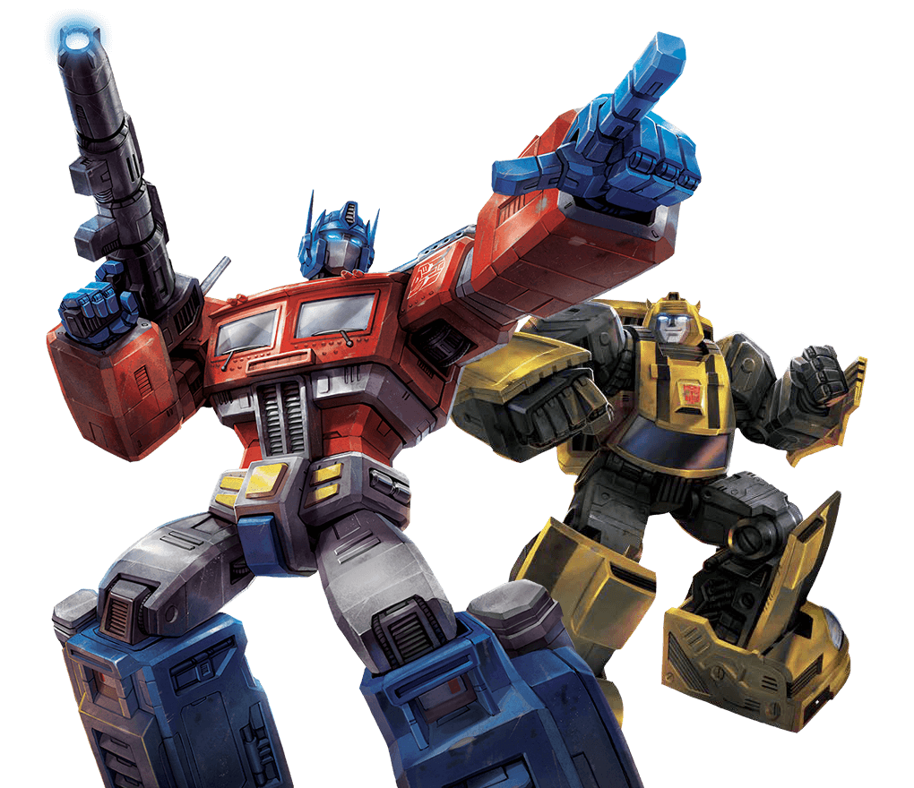
自注意力（Self-attention）
FC
FC
FC
FC
Self-attention
FC
FC
FC
FC
Self-attention
Attention is all you need.
https://arxiv.org/abs/1706.03762

Slide 8
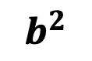
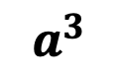
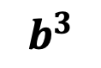
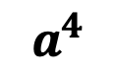
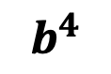
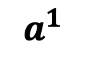
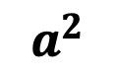
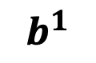
$$b^{1}$$
$$b^{2}$$
$$b^{3}$$
$$b^{4}$$
$$a^{1}$$
$$a^{2}$$
$$a^{3}$$
$$a^{4}$$
输入或隐含层

Slide 9
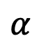
Self-attention
$$b^{1}$$
$$α$$
相关?
$$a^{1}$$
$$a^{2}$$
$$a^{3}$$
$$a^{4}$$
在序列中找到相关的向量

Slide 10
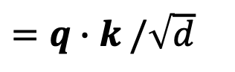
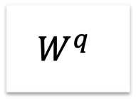

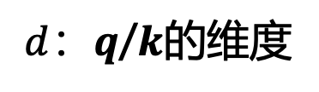
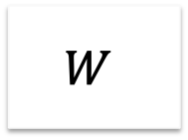
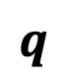
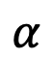
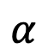
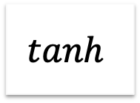
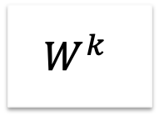
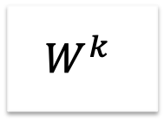
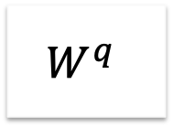
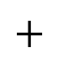
相关性计算
$$α$$
加法
$$W$$
点积
$d$：$q$/$k$的维度
$$α$$
$=q∙k$ $/\sqrt{d}$
$$tanh$$
$$q$$
$$k$$
$$+$$
$$W^{q}$$
$$W^{k}$$
$$W^{q}$$
$$W^{k}$$
Notes:
Does normalization important???

Slide 11
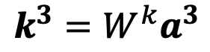
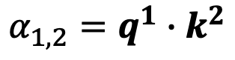
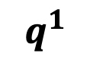
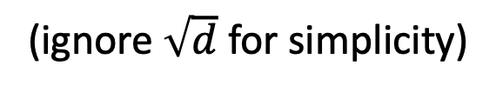
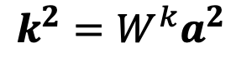
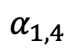
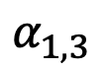
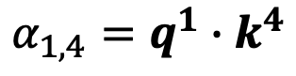
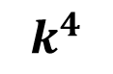
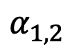
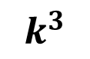
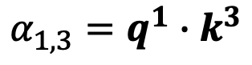
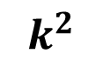
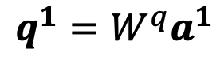
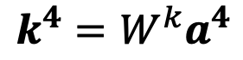
(ignore $\sqrt{d}$ for simplicity)
$$α_{1,2}=q^{1}∙k^{2}$$
$$α_{1,3}=q^{1}∙k^{3}$$
$$α_{1,4}=q^{1}∙k^{4}$$
attention score
$$α_{1,2}$$
$$α_{1,3}$$
$$α_{1,4}$$
$$q^{1}$$
query
$$k^{2}$$
key
$$k^{3}$$
$$k^{4}$$
$$a^{1}$$
$$a^{2}$$
$$a^{3}$$
$$a^{4}$$
$$q^{1}=W^{q}a^{1}$$
$$k^{2}=W^{k}a^{2}$$
$$k^{3}=W^{k}a^{3}$$
$$k^{4}=W^{k}a^{4}$$

Slide 12
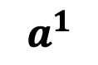
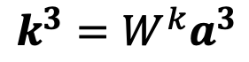
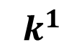
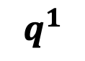
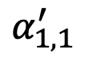
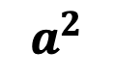
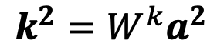
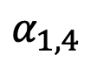
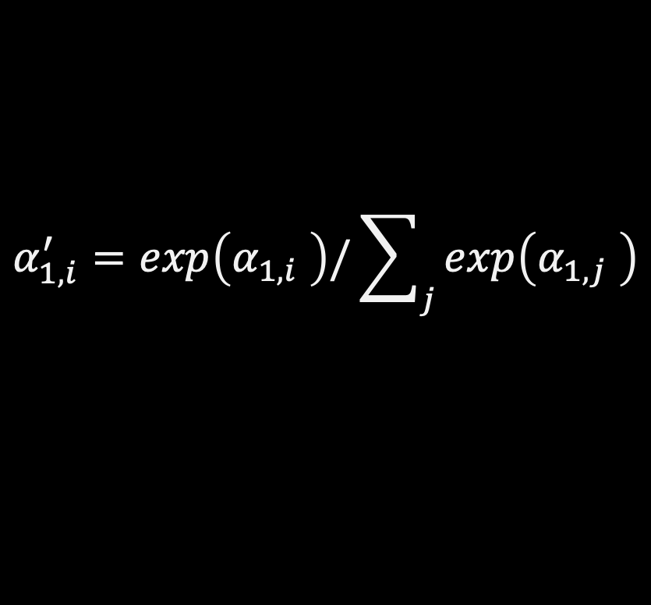
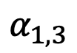
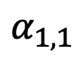
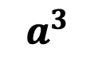
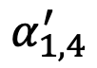







$$α_{1,i}^{′}=exp\left(α_{1,i} \right)/\sum_{j}{exp\left(α_{1,j} \right)}$$
$$α_{1,1}^{′}$$
$$α_{1,2}^{′}$$
$$α_{1,3}^{′}$$
$$α_{1,4}^{′}$$
Soft-max
$$α_{1,1}$$
$$α_{1,2}$$
$$α_{1,3}$$
$$α_{1,4}$$
$$q^{1}$$
$$k^{1}$$
$$k^{2}$$
$$k^{3}$$
$$k^{4}$$
$$a^{1}$$
$$a^{2}$$
$$a^{3}$$
$$a^{4}$$
$$q^{1}=W^{q}a^{1}$$
$$k^{2}=W^{k}a^{2}$$
$$k^{3}=W^{k}a^{3}$$
$$k^{4}=W^{k}a^{4}$$
$$k^{1}=W^{k}a^{1}$$

Slide 13


















$$b^{1}=\sum_{i}{α_{1,i}^{′}v^{i} }$$
根据注意力分数提取信息
$$b^{1}$$
$$α_{1,1}^{′}$$
$$α_{1,2}^{′}$$
$$α_{1,3}^{′}$$
$$α_{1,4}^{′}$$
$$q^{1}$$
$$k^{1}$$
$$v^{1}$$
$$k^{2}$$
$$v^{2}$$
$$k^{3}$$
$$v^{3}$$
$$k^{4}$$
$$v^{4}$$
$$a^{1}$$
$$a^{2}$$
$$a^{3}$$
$$a^{4}$$
$$v^{1}=W^{v}a^{1}$$
$$v^{2}=W^{v}a^{2}$$
$$v^{3}=W^{v}a^{3}$$
$$v^{4}=W^{v}a^{4}$$

Slide 14






并行
$$b^{1}$$
$$b^{2}$$
$$b^{3}$$
$$b^{4}$$
$$a^{1}$$
$$a^{2}$$
$$a^{3}$$
$$a^{4}$$
输入或隐含层

Slide 15

















$$b^{2}=\sum_{i}{α_{2,i}^{′}v^{i} }$$
$$b^{2}$$
$$α_{2,1}^{′}$$
$$α_{2,2}^{′}$$
$$α_{2,3}^{′}$$
$$α_{2,4}^{′}$$
$$q^{1}$$
$$k^{1}$$
$$v^{1}$$
$$q^{2}$$
$$k^{2}$$
$$v^{2}$$
$$q^{3}$$
$$k^{3}$$
$$v^{3}$$
$$q^{4}$$
$$k^{4}$$
$$v^{4}$$
$$a^{1}$$
$$a^{2}$$
$$a^{3}$$
$$a^{4}$$
Notes:
Relation between attention and CNN
Global receptive field (compared to convolutional architectures)

Slide 16


















































$$q^{1}$$
$$q^{2}$$
$$q^{3}$$
$$q^{4}$$
$$a^{1}$$
$$a^{2}$$
=
$$a^{3}$$
$$q^{i}=W^{q}a^{i}$$
$$W^{q}$$
$$a^{4}$$
$$Q$$
$$I$$
$$a^{1}$$
$$a^{2}$$
$$k^{1}$$
$$a^{3}$$
$$k^{2}$$
$$a^{4}$$
$$k^{3}$$
$$k^{i}=W^{k}a^{i}$$
$$k^{4}$$
=
$$W^{k}$$
$$K$$
$$I$$
$$a^{1}$$
$$a^{2}$$
$$a^{3}$$
$$v^{1}$$
$$a^{4}$$
$$v^{2}$$
$$v^{3}$$
$$v^{i}=W^{v}a^{i}$$
$$v^{4}$$
=
$$W^{v}$$
$$V$$
$$I$$
$$q^{1}$$
$$k^{1}$$
$$v^{1}$$
$$q^{2}$$
$$k^{2}$$
$$v^{2}$$
$$q^{3}$$
$$k^{3}$$
$$v^{3}$$
$$q^{4}$$
$$k^{4}$$
$$v^{4}$$
$$a^{1}$$
$$a^{2}$$
$$a^{3}$$
$$a^{4}$$

Slide 17






































$$α_{1,1}$$
$$k^{1}$$
$$α_{1,1}=$$
$$k^{1}$$
$$q^{1}$$
$$α_{1,2}=$$
$$k^{2}$$
$$q^{1}$$
$$α_{1,2}$$
$$k^{2}$$
$$=$$
$$q^{1}$$
$$α_{1,3}$$
$$k^{3}$$
$$α_{1,3}=$$
$$k^{3}$$
$$q^{1}$$
$$α_{1,4}=$$
$$k^{4}$$
$$q^{1}$$
$$α_{1,4}$$
$$k^{4}$$
$$α_{1,1}$$
$$α_{1,2}$$
$$α_{1,3}$$
$$α_{1,4}$$
$$q^{1}$$
$$k^{1}$$
$$v^{1}$$
$$q^{2}$$
$$k^{2}$$
$$v^{2}$$
$$q^{3}$$
$$k^{3}$$
$$v^{3}$$
$$q^{4}$$
$$k^{4}$$
$$v^{4}$$
Notes:
Relation between attention and CNN
Global receptive field (compared to convolutional architectures)
(ignore $\sqrt{d}$ for simplicity)

Slide 18






































































$$α_{1,1}$$
$$k^{1}$$
$$α_{1,1}=$$
$$k^{1}$$
$$q^{1}$$
$$α_{1,2}=$$
$$k^{2}$$
$$q^{1}$$
$$α_{1,2}$$
$$k^{2}$$
$$=$$
$$q^{1}$$
$$k^{3}$$
$$q^{1}$$
$$k^{4}$$
$$q^{1}$$
$$α_{1,3}$$
$$k^{3}$$
$$α_{1,3}=$$
$$α_{1,4}=$$
$$α_{1,4}$$
$$k^{4}$$
$$α_{2,1}$$
$$α_{2,2}$$
$$α_{2,3}$$
$$α_{2,4}$$
$$q^{1}$$
$$k^{1}$$
$$v^{1}$$
$$q^{2}$$
$$k^{2}$$
$$v^{2}$$
$$q^{3}$$
$$k^{3}$$
$$v^{3}$$
$$q^{4}$$
$$k^{4}$$
$$v^{4}$$
$$α_{1,1}^{′}$$
$$α_{2,1}^{′}$$
$$α_{3,1}^{′}$$
$$α_{4,1}^{′}$$
$$α_{1,1}$$
$$α_{2,1}$$
$$α_{3,1}$$
$$α_{4,1}$$
$$k^{1}$$
$$α_{1,2}^{′}$$
$$α_{2,2}^{′}$$
$$α_{3,2}^{′}$$
$$α_{4,2}^{′}$$
$$α_{1,2}$$
$$α_{2,2}$$
$$α_{3,2}$$
$$α_{4,2}$$
$$k^{2}$$
$$α_{1,3}^{′}$$
$$α_{2,3}^{′}$$
$$α_{3,3}^{′}$$
$$=$$
$$q^{1}$$
$$q^{2}$$
$$q^{3}$$
$$q^{4}$$
$$α_{4,3}^{′}$$
$$α_{1,3}$$
$$α_{2,3}$$
$$α_{3,3}$$
$$α_{4,3}$$
$$k^{3}$$
$$α_{1,4}^{′}$$
$$α_{2,4}^{′}$$
$$α_{3,4}^{′}$$
$$α_{4,4}^{′}$$
$$α_{1,4}$$
$$α_{2,4}$$
$$α_{3,4}$$
$$α_{4,4}$$
$$k^{4}$$
$$Q$$
$$A′$$
softmax
$$A$$
$$K^{T}$$
Notes:
Relation between attention and CNN
Global receptive field (compared to convolutional architectures)

Slide 19








































$$b^{1}$$
$$α_{1,1}^{′}$$
$$α_{1,2}^{′}$$
$$α_{1,3}^{′}$$
$$α_{1,4}^{′}$$
$$q^{1}$$
$$k^{1}$$
$$v^{1}$$
$$q^{2}$$
$$k^{2}$$
$$v^{2}$$
$$q^{3}$$
$$k^{3}$$
$$v^{3}$$
$$q^{4}$$
$$k^{4}$$
$$v^{4}$$
$$α_{1,1}^{′}$$
$$α_{2,1}^{′}$$
$$α_{3,1}^{′}$$
$$α_{4,1}^{′}$$
$$α_{1,2}^{′}$$
$$α_{2,2}^{′}$$
$$α_{3,2}^{′}$$
$$α_{4,2}^{′}$$
$$b^{1}$$
=
$$b^{2}$$
$$b^{3}$$
$$b^{4}$$
$$v^{1}$$
$$v^{2}$$
$$v^{3}$$
$$v^{4}$$
$$α_{1,3}^{′}$$
$$α_{2,3}^{′}$$
$$α_{3,3}^{′}$$
$$α_{4,3}^{′}$$
$$O$$
$$V$$
$$α_{1,4}^{′}$$
$$α_{3,4}^{′}$$
$$α_{2,4}^{′}$$
$$α_{4,4}^{′}$$
$$A′$$
Notes:
Relation between attention and CNN
Global receptive field (compared to convolutional architectures)

Slide 20
















$$Q$$
=
$$I$$
$$W^{q}$$
$$K$$
=
$$I$$
$$W^{k}$$
$$V$$
=
$$I$$
$$W^{v}$$
待学习的参数
$$A′$$
$$A$$
=
$$Q$$
$$K^{T}$$
注意力矩阵
$$A′$$
$$O$$
=
$$V$$
Notes:
反正就是一堆矩陣乘法，用 GPU 可以加速

Slide 21
























多头注意力
$$q^{i,1}=W^{q,1}q^{i}$$
$$b^{i,1}$$
不同类型的相关性
$$q^{i,2}=W^{q,2}q^{i}$$
$$q^{i,1}$$
$$q^{i,2}$$
$$k^{i,1}$$
$$k^{i,2}$$
$$v^{i,1}$$
$$v^{i,2}$$
$$q^{j,1}$$
$$q^{j,2}$$
$$k^{j,1}$$
$$k^{j,2}$$
$$v^{j,1}$$
$$v^{j,2}$$
$$q^{i}$$
$$k^{i}$$
$$v^{i}$$
$$q^{j}$$
$$k^{j}$$
$$v^{j}$$
$$q^{i}=W^{q}a^{i}$$
$$a^{i}$$
(以2头为例)
$$a^{j}$$

Slide 22


多头注意力
$$q^{i,1}=W^{q,1}q^{i}$$
$$b^{i,1}$$
不同类型的相关性
$$q^{i,2}=W^{q,2}q^{i}$$
$$b^{i,2}$$
$$q^{i,1}$$
$$q^{i,2}$$
$$k^{i,1}$$
$$k^{i,2}$$
$$v^{i,1}$$
$$v^{i,2}$$
$$q^{j,1}$$
$$q^{j,2}$$
$$k^{j,1}$$
$$k^{j,2}$$
$$v^{j,1}$$
$$v^{j,2}$$
$$q^{i}$$
$$k^{i}$$
$$v^{i}$$
$$q^{j}$$
$$k^{j}$$
$$v^{j}$$
$$q^{i}=W^{q}a^{i}$$
$$a^{i}$$
(以2头为例)
$$a^{j}$$

Slide 23


多头注意力
不同类型的相关性
$$b^{i,1}$$
$$b^{i}$$
=
$$W^{O}$$
$$b^{i,2}$$
$$q^{i,1}$$
$$q^{i,2}$$
$$k^{i,1}$$
$$k^{i,2}$$
$$v^{i,1}$$
$$v^{i,2}$$
$$q^{j,1}$$
$$q^{j,2}$$
$$k^{j,1}$$
$$k^{j,2}$$
$$v^{j,1}$$
$$v^{j,2}$$
$$q^{i}$$
$$k^{i}$$
$$v^{i}$$
$$q^{j}$$
$$k^{j}$$
$$v^{j}$$
$$q^{i}=W^{q}a^{i}$$
$$a^{i}$$
(以2头为例)
$$a^{j}$$

Slide 24








位置编码（Positional Encoding）
自注意力中没有位置信息。
每个位置对应一个唯一的位置向量$e^{i}$
手动设计
从数据中学习
每列表示一个位置编码 $e^{i}$
偶数位置：sin函数
奇数位置：cos函数
计算注意力分数
（点积）时，相对位置的变化会对注意力产生影响，绝对位置变化不会对注意力产生影响。
$$q^{i}$$
$$k^{i}$$
$$v^{i}$$
不同位置编码方案的比较https://arxiv.org/abs/2003.09229
+
$$e^{i}$$
$$a^{i}$$
-1
1
Notes:
A real example of positional encoding for 20 words (rows) with an embedding size of 512 (columns). You can see that it appears split in half down the center. That's because the values of the left half are generated by one function (which uses sine), and the right half is generated by another function (which uses cosine). They're then concatenated to form each of the positional encoding vectors.

Slide 25












应用：语音
https://arxiv.org/abs/1910.12977
Attention in a range
Speech is a very long vector sequence.
$$b^{1}$$
$$b^{2}$$
$$b^{3}$$
$$b^{4}$$
10ms
If input sequence is length $L$
$$A′$$
$$L$$
$$a^{1}$$
$$a^{2}$$
$$a^{3}$$
$$a^{4}$$
Attention Matrix
$$L$$
Truncated Self-attention

Slide 26


应用：图像
An image can also be considered as a vector set.
This is a vector.
Source of image: https://www.researchgate.net/figure/Color-image-representation-and-RGB-matrix_fig15_282798184

Slide 27
Self-attention v.s. CNN
1 | 0 | 0 | 0 | 0 | 1
0 | 1 | 0 | 0 | 1 | 0
0 | 0 | 1 | 1 | 0 | 0
1 | 0 | 0 | 0 | 1 | 0
0 | 1 | 0 | 0 | 1 | 0
0 | 0 | 1 | 0 | 1 | 0
CNN: self-attention that can only attends in a receptive field
1 | 0 | 0 | 0 | 0 | 1
0 | 1 | 0 | 0 | 1 | 0
0 | 0 | 1 | 1 | 0 | 0
1 | 0 | 0 | 0 | 1 | 0
0 | 1 | 0 | 0 | 1 | 0
0 | 0 | 1 | 0 | 1 | 0
1 | 0 | 0 | 0 | 0 | 1
0 | 1 | 0 | 0 | 1 | 0
0 | 0 | 1 | 1 | 0 | 0
1 | 0 | 0 | 0 | 1 | 0
0 | 1 | 0 | 0 | 1 | 0
0 | 0 | 1 | 0 | 1 | 0
CNN is simplified self-attention.
Self-attention: CNN with learnable receptive field
Self-attention is the complex version of CNN.

Slide 28



Self-attention v.s. CNN
Self-attention
CNN
$$N_{h}=K×K$$
On the Relationship between Self-Attention and Convolutional Layers
https://arxiv.org/abs/1911.03584
Notes:
Shall I explain this more …?
ICLR 2020

Slide 29

Self-attention v.s. CNN
Good for more data
Self-attention
Good for less data
CNN
An Image is Worth 16x16 Words: Transformers for Image Recognition at Scale
https://arxiv.org/pdf/2010.11929.pdf
Notes:
Self needs more data to work
Vision Transformer (ViT)
ViT-L/16 means the “Large” variant with 16×16 input patch size.

Slide 30

Self-attention v.s. RNN
FC
FC
FC
FC
memory
RNN
RNN
RNN
RNN
hard to consider
nonparallel
parallel
Self-attention
easy to consider
Transformers are RNNs: Fast Autoregressive Transformers with Linear Attention
https://arxiv.org/abs/2006.16236
Notes:
RNN + attention https://arxiv.org/abs/1611.08656
天涯若比邻

Slide 31
深度学习简介
神经元结构
全连接前馈神经网络
为什么要用深度模型
卷积神经网络
循环神经网络
自注意力
Transformer
Outline

Slide 32


序列 to 序列
output sequence
Encoder
Decoder
Input sequence
Sequence to Sequence Learning with Neural Networks
Transformer
https://arxiv.org/abs/1409.3215
https://arxiv.org/abs/1706.03762
Notes:
Sequence to Sequence Learning with Neural Networks
Ilya Sutskever, Oriol Vinyals, Quoc V. Le

Slide 33
Encoder
output sequence
Encoder
Decoder
Input sequence

Slide 34









Encoder
Transformer’s Encoder
You can use RNN or CNN.
$$h^{1}$$
$$h^{2}$$
$$h^{3}$$
$$h^{4}$$
Encoder
$$x^{1}$$
$$x^{2}$$
$$x^{3}$$
$$x^{4}$$
Notes:
可以用 CNN, RNN
不用拘泥於 Transformer’s Encoder

Slide 35








$$h^{1}$$
$$h^{2}$$
$$h^{3}$$
$$h^{4}$$
Block
…
…
…
…
FC
FC
FC
FC
Block
Block
Self-attention
$$x^{1}$$
$$x^{2}$$
$$x^{3}$$
$$x^{4}$$

Slide 36









…
$$\left[\begin{aligned}x_{1}^{′} \\ x_{2}^{′} \\ ⋮ \\ x_{K}^{′}\end{aligned}\right]$$
$$x_{i}^{′}=\frac{x_{i}−m}{σ}$$
norm
Layer Norm
norm
https://arxiv.org/abs/1607.06450
+
norm
residual
$$a+b$$
$$\left[\begin{aligned}x_{1} \\ x_{2} \\ ⋮ \\ x_{K}\end{aligned}\right]$$
FC
mean $m$
$$b$$
+
$$a$$
standard deviation $σ$
Self-attention

Slide 37

BERT
I use the same network architecture as transformer encoder.
$$h^{1}$$
$$h^{2}$$
$$h^{3}$$
$$h^{4}$$
Encoder
Residual
+ Layer norm
$$x^{1}$$
$$x^{2}$$
$$x^{3}$$
$$x^{4}$$

Slide 38

To learn more ……
On Layer Normalization in the Transformer Architecture
https://arxiv.org/abs/2002.04745
PowerNorm: Rethinking Batch Normalization in Transformers
https://arxiv.org/abs/2003.07845
Notes:
Why not BN?
https://arxiv.org/pdf/2003.07845.pdf
=======
This is about initialization
https://arxiv.org/pdf/1908.11365.pdf

Slide 39
Decoder
output sequence
Encoder
Decoder
Input sequence

Slide 40
Decoder — Autoregressive (AT) –
output sequence
Encoder
Decoder
Input sequence

Slide 41

Autoregressive
distribution
(Speech Recognition as example)
学 | 0.0
机 | 0.8
器 | 0.0
学 | 0.1
…… | ……
机
Size V
max
(common characters)
softmax
Encoder
Decoder
(机器学习)
(special token)
START
Notes:
What is BOS?
Should I talk about sampling???

Slide 42
Autoregressive
机
器
学
习
max
max
max
max
Encoder
Decoder
( 机器学习)
START
机
器
学
Notes:
What is BOS? 误差累计，一步错，步步错

Slide 43

ignore the input from the encoder here ☺
機
器
學
習
max
max
max
max
Decoder
START
機
器
學
Notes:
What is BOS?

Slide 44
Encoder
Decoder

Slide 45
Self-attention → Masked Self-attention
$$b^{1}$$
$$b^{2}$$
$$b^{3}$$
$$b^{4}$$
$$a^{1}$$
$$a^{2}$$
$$a^{3}$$
$$a^{4}$$
Can be either input or a hidden layer
Notes:
Masked: attend on the generated sequence

Slide 46









$$b^{2}$$
$$α_{2,1}^{′}$$
$$α_{2,2}^{′}$$
$$α_{2,3}^{′}$$
$$α_{2,4}^{′}$$
$$q^{1}$$
$$k^{1}$$
$$v^{1}$$
$$q^{2}$$
$$k^{2}$$
$$v^{2}$$
$$q^{3}$$
$$k^{3}$$
$$v^{3}$$
$$q^{4}$$
$$k^{4}$$
$$v^{4}$$
$$a^{1}$$
$$a^{2}$$
$$a^{3}$$
$$a^{4}$$
Consider how does decoder work
Why masked?
Notes:
Relation between attention and CNN
Global receptive field (compared to convolutional architectures)

Slide 47
Autoregressive
气
机
器
学
习
max
Encoder
Decoder
Decoder
Output
( 机器学习 )
START
器
学
机
气

Slide 48
Autoregressive
We do not know the correct output length.
Never stop!
机
器
学
习
惯
……
max
max
max
max
max
Encoder
Decoder
( 机器学习 )
START
机
器
学
习

Slide 49
distribution
Adding “Stop Token”
学 | 0.0
机 | 0.8
器 | 0.0
习 | 0.1
…… | ……
END | 0.0
Size V
(common characters)
softmax
Encoder
Decoder
( 机器学习)
START
Notes:
What is BOS?

Slide 50
Autoregressive
Stop at here!
机
器
学
习
END
max
max
max
max
max
Encoder
Decoder
( 机器学习)
START
机
器
学
习

Slide 51
Decoder – Non-autoregressive (NAT)
output sequence
Encoder
Decoder
Input sequence

Slide 52
AT v.s. NAT
w₁
w₃
w₁
END
w₂
END
w₂
w₃
w₄
AT Decoder
NAT Decoder
START
w₁
w₂
w₃
START
START
START
START
How to decide the output length for NAT decoder?
Another predictor for output length
Output a very long sequence, ignore tokens after END
Advantage: parallel, more stable generation (e.g., TTS)
(why? Multi-modality)
NAT is usually worse than AT

Slide 53
Encoder-Decoder
output sequence
Encoder
Decoder
Input sequence

Slide 54

Transformer
Cross attention
Notes:
I need to know consider which layer?

Slide 55














FC
$$v$$
$$α_{1}^{′}$$
$$α_{2}^{′}$$
$$α_{3}^{′}$$
Cross attention
$$k^{1}$$
$$v^{1}$$
$$k^{2}$$
$$v^{2}$$
$$k^{3}$$
$$v^{3}$$
$$q$$
$$a^{1}$$
$$a^{2}$$
$$a^{3}$$
Encoder
Self-attention (Mask)
START

Slide 56


FC
$$v′$$
$$α_{1}^{′}$$
$$α_{2}^{′}$$
$$α_{3}^{′}$$
$$k^{1}$$
$$v^{1}$$
$$k^{2}$$
$$v^{2}$$
$$k^{3}$$
$$v^{3}$$
$$q′$$
$$a^{1}$$
$$a^{2}$$
$$a^{3}$$
Encoder
Self-attention (Mask)
START
機

Slide 57


Cross Attention
Source of image:
https://arxiv.org/abs/2005.08081
Notes:
https://arxiv.org/pdf/2005.08081.pdf?fbclid=IwAR3R4ezzOjQ0JN_dyH0RTbDJDuFKVgHdSPr30hCKAX58Q40OkAV72nlMSxE

Slide 58
Training
output sequence
Encoder
Decoder
Input sequence

Slide 59
Ground truth
学 | 0
机 | 1
器 | 0
鬼 | 0
…… | ……
机
distribution
学 | 0.1
机 | 0.7
器 | 0.1
鬼 | 0.1
…… | ……
Size V
minimize cross entropy
(common characters)
softmax
Encoder
Decoder
Label: 机 器 学 习
<BOS>
Notes:
What is BOS?

Slide 60
Teacher Forcing: using the ground truth as input.
机
器
学
习
<EOS>
minimize cross entropy
Encoder
Decoder
Ground Truth
Label: 机 器 学 习
<BOS>
机
器
学
习
Notes:
What is BOS?
目标函数不好优化：采用强化学习策略

Slide 61
There is a mismatch! ☹
机
器
学
exposure bias
機
气
学
Decoder
Decoder
START
机
气
<BOS>
器
机
气
Ground Truth
Notes:
Exposure 曝光

Slide 62


Scheduled Sampling
Original Scheduled Sampling
Scheduled Sampling for Transformer
Parallel Scheduled Sampling
https://arxiv.org/abs/1506.03099
https://arxiv.org/abs/1906.07651
https://arxiv.org/abs/1906.04331

Slide 63


各式各样的Transformer
Long Range Arena: A Benchmark for Efficient Transformers
https://arxiv.org/abs/2011.04006
Efficient Transformers: A Survey
https://arxiv.org/abs/2009.06732

Slide 64





How to make self-attention efficient?
key
Sequence length
= 𝑁
𝑁
𝑁
query
Attention Matrix
𝑁 × 𝑁

Slide 65



Notice
Self-attention is only a module in a larger network.
Self-attention dominates computation when 𝑁 is large.
Usually developed for image processing
256
𝑁 = 256 ∗ 256
256

Slide 66
Skip Some Calculations with Human Knowledge
Can we fill in some values with human knowledge?

Slide 67



Local Attention / Truncated Attention
Set to 0
query
……
Similar with CNN
Calculate attention weight
key

Slide 68


Stride Attention
…
…

Slide 69



Global Attention
special token = “token中的班长“
Add special token into original sequence
Attend to every token → collect global information
Attended by every token → it knows global information
…
No attention
…
between non- special token

Slide 70
Many Different Choices …
小孩子才做选择．．．
Different heads use different patterns.

Slide 71


Many Different Choices …
Longformer
https://arxiv.org/abs/2004.05150
Big Bird
https://arxiv.org/abs/2007.14062

Slide 72
Can we only focus on Critical Parts?
key
small value
Directly set to 0
Smaller influence on results
large value
How to quickly estimate the portion with small attention weights?
query

Slide 73












Clustering
Reformer
https://openreview.net/forum?id=rkgNKkHtvB
Routing Transformer
https://arxiv.org/abs/2003.05997
Step 1
query
key
Clustering based on similarity
(approximate & fast)
1 4 1 2 3 3 3 2
2 1 3 3 1 4 1 4

Slide 74


Clustering
key
Step 2
query
Belong to the same cluster, then calculate attention weight
Not the same cluster, set to 0

Slide 75






Learnable Patterns
https://arxiv.org/abs/2002.11296
Input sequence
Sinkhorn Sorting Network
key
NN
Jointly learned
query
A grid should be skipped or not is decided by another learned module
(simplified version)

Slide 76
Do we need full attention matrix?
Linformer
Many redundant columns
https://arxiv.org/abs/2006.04768
query
key
Low Rank

Slide 77










𝑁
key
𝑁
value
𝐾
𝐾
Representative
keys
output
Can we reduce the number of queries?
Changed output sequence length
query
查询的数目与输出token数目相同

Slide 78



Reduce Number of Keys
Compressed Attention
https://arxiv.org/abs/1801.10198
Linformer
https://arxiv.org/abs/2006.04768
𝑁
𝑑
Conv
Conv
Conv
Conv
𝑁 × 𝐾
𝑑
𝐾
Linear combination
of $N$ vectors

Slide 79















Attention Mechanism is three-matrix Multiplication
Review
Q
𝑑 × 𝑁
=
_{𝑊}𝑞
I
𝑑 × 𝑁
K
=
_{𝑊}𝑘
I
𝑑′ × 𝑁
V
=
_{𝑊}𝑣
I
A′
A
_{𝐾}𝑇
=
Q
softmax ignore
O
=
V
A′

Slide 80

Attention Mechanism is three-matrix Multiplication
Review
Q
𝑑 × 𝑁
=
_{𝑊}𝑞
I
𝑑 × 𝑁
K
=
_{𝑊}𝑘
I
𝑑′ × 𝑁
V
=
_{𝑊}𝑣
I
_{𝐾}𝑇
O
≈
V
Q
𝑑′ × 𝑁
𝑑′ × 𝑁
𝑑 × 𝑁
𝑁 × 𝑑

Slide 81








_{𝐾}𝑇
O
≈
V
Q
𝑑′ × 𝑁
𝑑′ × 𝑁
𝑑 × 𝑁
𝑁 × 𝑑
_{𝐾}𝑇
O
≈
V
Q
𝑑′ × 𝑁
𝑑′ × 𝑁
𝑑 × 𝑁
What is the difference?
𝑁 × 𝑑

Slide 82


Review Linear Algebra

Slide 83


_{𝐾}𝑇
O
≈
V
Q
𝑑 + 𝑑′ 𝑁²
𝑑′ × 𝑁
𝑑′ × 𝑁
𝑑 × 𝑁
𝑁 × 𝑑
𝑁 × 𝑑 × 𝑁
A
V
Attention
Matrix
𝑑′ × 𝑁
𝑁 × 𝑁
𝑑′ × 𝑁 × 𝑁

Slide 84


_{𝐾}𝑇
O
≈
V
Q
2𝑑′𝑑𝑁
𝑑′ × 𝑁
𝑑′ × 𝑁
𝑑 × 𝑁
𝑁 × 𝑑
𝑑′ × 𝑁 × 𝑑
𝑑 × 𝑁
?
Q
𝑑′ × 𝑑
𝑑′ × 𝑑 × 𝑁

Slide 85
_{𝐾}𝑇
O
≈
V
Q
𝑑 + 𝑑′ 𝑁²
𝑑 × 𝑁
𝑑 × 𝑁
𝑑 × 𝑁
𝑁 × 𝑑
>
_{𝐾}𝑇
O
≈
V
Q
2𝑑′𝑑𝑁
𝑑 × 𝑁
𝑑 × 𝑁
𝑑 × 𝑁
𝑁 × 𝑑

Slide 86
Let's put softmax back …
Warning of math

Slide 87




















$$b^{1}=\sum_{i=1}^{N}{α_{1,i}^{′}v^{i}}=\sum_{i=1}^{N}{\frac{exp\left(b^{1}∙k^{i}\right)}{\sum_{j=1}^{N}{exp\left(b^{1}∙k^{j}\right)}}v^{i}}$$
$$b^{1}$$
_{𝛼}′
_{𝛼}′
_{𝛼}′
_{𝛼}′
1,1
1,2
1,3
1,4
_{𝒒}𝟏
_{𝒌}𝟏
_{𝒗}𝟏
_{𝒌}𝟐
_{𝒗}𝟐
_{𝒌}𝟑
_{𝒗}𝟑
_{𝒌}𝟒
_{𝒗}𝟒
_{𝒂}𝟏
_{𝒂}𝟐
_{𝒂}𝟑
_{𝒂}𝟒

Slide 88







$$b^{1}=\sum_{i=1}^{N}{α_{1,i}^{′}v^{i}}=\sum_{i=1}^{N}{\frac{exp\left(q^{1}∙k^{i}\right)}{\sum_{j=1}^{N}{exp\left(q^{1}∙k^{j}\right)}}v^{i}}$$
$$exp\left(q∙k\right)$$
$$=\sum_{i=1}^{N}{\frac{ϕ\left(q^{1}\right)∙ϕ\left(k^{i}\right)}{\sum_{j=1}^{N}{ϕ\left(q^{1}\right)∙ϕ\left(k^{j}\right)}}v^{i}}$$
$$≈ϕ\left(q\right)∙ϕ\left(k\right)$$
$$=\frac{\sum_{i=1}^{N}{\left[ϕ\left(q^{1}\right)∙ϕ\left(k^{i}\right)\right]v^{i}}}{\sum_{j=1}^{N}{ϕ\left(q^{1}\right)∙ϕ\left(k^{j}\right)}}$$

Slide 89




$$b^{1}=\frac{\sum_{i=1}^{N}{\left[ϕ\left(q^{1}\right)∙ϕ\left(k^{i}\right)\right]v^{i}}}{\sum_{j=1}^{N}{ϕ\left(q^{1}\right)∙ϕ\left(k^{j}\right)}}$$
$$ϕ\left(q^{1}\right)=\left[\begin{matrix}q_{1}^{1} \\ q_{2}^{1} \\ ⋮\end{matrix}\right]$$
$$ϕ\left(k^{1}\right)=\left[\begin{matrix}k_{1}^{1} \\ k_{2}^{1} \\ ⋮\end{matrix}\right]$$
$$\sum_{i=1}^{N}{\left[ϕ\left(q^{1}\right)∙ϕ\left(k^{i}\right)\right]v^{i}}$$
$$=ϕ\left(q^{1}\right)∙ϕ\left(k^{1}\right)v^{1}+ϕ\left(q^{2}\right)∙ϕ\left(k^{2}\right)v^{2}+…$$
$$=\left(q_{1}^{1}k_{1}^{1}+q_{2}^{1}k_{2}^{1}+…\right)v^{1}+\left(q_{1}^{1}k_{1}^{2}+q_{2}^{1}k_{2}^{2}+…\right)v^{2}+…$$
$$=q_{1}^{1}k_{1}^{1}v^{1}+q_{2}^{1}k_{2}^{1}v^{1}+…+q_{1}^{1}k_{1}^{2}v^{2}+q_{2}^{1}k_{2}^{2}v^{2}+…+…$$
$$=q_{1}^{1}\left(k_{1}^{1}v^{1}+k_{1}^{2}v^{2}+…\right)+q_{2}^{1}\left(k_{2}^{1}v^{1}+k_{2}^{2}v^{2}+…\right)+…$$

Slide 90








$$b^{1}=\frac{\sum_{i=1}^{N}{\left[ϕ\left(q^{1}\right)∙ϕ\left(k^{i}\right)\right]v^{i}}}{\sum_{j=1}^{N}{ϕ\left(q^{1}\right)∙ϕ\left(k^{j}\right)}}$$
$$ϕ\left(q^{1}\right)=\left[\begin{matrix}q_{1}^{1} \\ q_{2}^{1} \\ ⋮\end{matrix}\right]$$
$$ϕ\left(k^{1}\right)=\left[\begin{matrix}k_{1}^{1} \\ k_{2}^{1} \\ ⋮\end{matrix}\right]$$
$$\sum_{i=1}^{N}{\left[ϕ\left(q^{1}\right)∙ϕ\left(k^{i}\right)\right]v^{i}}$$
$M$维
$$=q_{1}^{1}\left(k_{1}^{1}v^{1}+k_{1}^{2}v^{2}+…\right)+q_{2}^{1}\left(k_{2}^{1}v^{1}+k_{2}^{2}v^{2}+…\right)+…$$
$$\sum_{j=1}^{N}{k_{2}^{j}v^{j}}$$
$$\sum_{j=1}^{N}{k_{1}^{j}v^{j}}$$
...
𝜙 𝒒^{𝟏}
$M$个向量

Slide 91









𝜙 𝒒^{𝟏}
𝒃^{𝟏} =
$$\sum_{j=1}^{N}{ϕ\left(k^{j}\right)}$$
𝜙 𝒒^{𝟏}
Don’t compute again
𝜙 𝒒^{𝟐}
𝒃^{𝟐} =
$$\sum_{j=1}^{N}{ϕ\left(k^{j}\right)}$$
……
𝜙 𝒒^{𝟐}
𝒃^{𝑵} = …

Slide 92
Let's put softmax back …
End of warning

Slide 93





















weighted sum
𝒗
=
𝒗^{𝟏} +
𝒗^{𝟐} +
𝒗^{𝟑} +
𝟒
$$ϕ\left(q^{1}\right)=\left[\begin{matrix}q_{1}^{1} \\ q_{2}^{1} \\ ⋮\end{matrix}\right]$$
𝒗
=
𝒗^{𝟏} +
𝒗^{𝟐} +
𝒗^{𝟑} +
𝟒
…
M vectors
M dimensions
𝜙 𝒌^{𝟏}
𝜙 𝒌^{𝟐}
𝜙 𝒌^{𝟑}
𝜙(𝒌⁴)
_{𝒗}𝟐
_{𝒗}𝟒
_{𝒌}𝟐
_{𝒗}𝟐
_{𝒌}𝟒
_{𝒌}𝟐
_{𝒗}𝟑
_{𝒗}𝟏
_{𝒗}𝟑
_{𝒗}𝟏
_{𝒌}𝟑
_{𝒌}𝟏
_{𝒌}𝟑
_{𝒗}𝟒
_{𝒒}𝟏
_{𝒌}𝟏
_{𝒌}𝟒
_{𝒂}𝟏
_{𝒂}𝟐
_{𝒂}𝟑
_{𝒂}𝟒

Slide 94

weighted sum
𝒗
=
𝒗^{𝟏} +
𝒗^{𝟐} +
𝒗^{𝟑} +
𝟒
$$ϕ\left(q^{1}\right)=\left[\begin{matrix}q_{1}^{1} \\ q_{2}^{1} \\ ⋮\end{matrix}\right]$$
𝒗
=
𝒗^{𝟏} +
𝒗^{𝟐} +
𝒗^{𝟑} +
𝟒
…
M vectors
𝜙 𝒒^{𝟏}
𝒃^{𝟏} =
$$\sum_{j=1}^{N}{ϕ\left(k^{j}\right)}$$
𝜙 𝒒^{𝟏}

Slide 95




template selection
= 𝒗^{𝟏} + template 1
𝒗
𝒗^{𝟐} +
𝒗^{𝟑} +
𝟒
𝒃^{𝟐} =?
$$ϕ\left(q^{2}\right)$$
= 𝒗^{𝟏} + template 2
𝒗
𝒗^{𝟐} +
𝒗^{𝟑} +
𝟒
…
M vectors
𝜙 𝒌^{𝟏}
𝜙 𝒌^{𝟐}
𝜙 𝒌^{𝟑}
𝜙 𝒌^{𝟒}
_{𝒒}𝟏
_{𝒌}𝟏
_{𝒗}𝟏
_{𝒒}𝟐
_{𝒌}𝟐
_{𝒗}𝟐
_{𝒌}𝟑
_{𝒗}𝟑
_{𝒌}𝟒
_{𝒗}𝟒
_{𝒂}𝟏
_{𝒂}𝟐
_{𝒂}𝟑
_{𝒂}𝟒

Slide 96
Realization
Efficient attention
https://arxiv.org/pdf/1812.01243.pdf
$$exp\left(q∙k\right)$$
Linear Transformer
https://linear-transformers.com/
$$≈ϕ\left(q\right)∙ϕ\left(k\right)$$
Random Feature Attention
https://arxiv.org/pdf/2103.02143.pdf
Performer
https://arxiv.org/pdf/2009.14794.pdf

Slide 97










Do we need q and k to compute attention? Synthesizer!
https://arxiv.org/abs/2005.00743
$$b^{1}$$
$$b^{2}$$
$$b^{3}$$
$$b^{4}$$
^{𝛼}1,1 | ^{𝛼}1,2 | ^{𝛼}1,3 | ^{𝛼}1,4
^{𝛼}1,2 | ^{𝛼}2,2 | ^{𝛼}2,3 | ^{𝛼}2,4
^{𝛼}1,3 | ^{𝛼}2,3 | ^{𝛼}3,3 | ^{𝛼}3,4
^{𝛼}1,4 | ^{𝛼}2,4 | ^{𝛼}3,4 | ^{𝛼}4,4
softmax
$$b^{1}=\sum_{i=1}^{N}{α_{1,i}^{′}v^{i}}$$
From q and k?
They are network
parameters!
𝒗
𝒗
𝒗
𝒗
𝟏
𝟐
𝟑
𝟒
_{𝒂}𝟏
_{𝒂}𝟐
_{𝒂}𝟑
_{𝒂}𝟒
Notes:
直接从a计算attention value

Slide 98


Attention-free?
Fnet: Mixing tokens with fourier transforms
https://arxiv.org/abs/2105.03824
Pay Attention to MLPs
https://arxiv.org/abs/2105.08050
MLP-Mixer: An all-MLP Architecture for Vision
https://arxiv.org/abs/2105.01601

Slide 99
Summary
Human knowledge
Local Attention, Big Bird
Clustering
Reformer
Learnable Pattern
Sinkforn
Representative key
Linformer
k,q first → v,k first
Linear Transformer, Performer
New framework
Synthesizer

